Slide 1
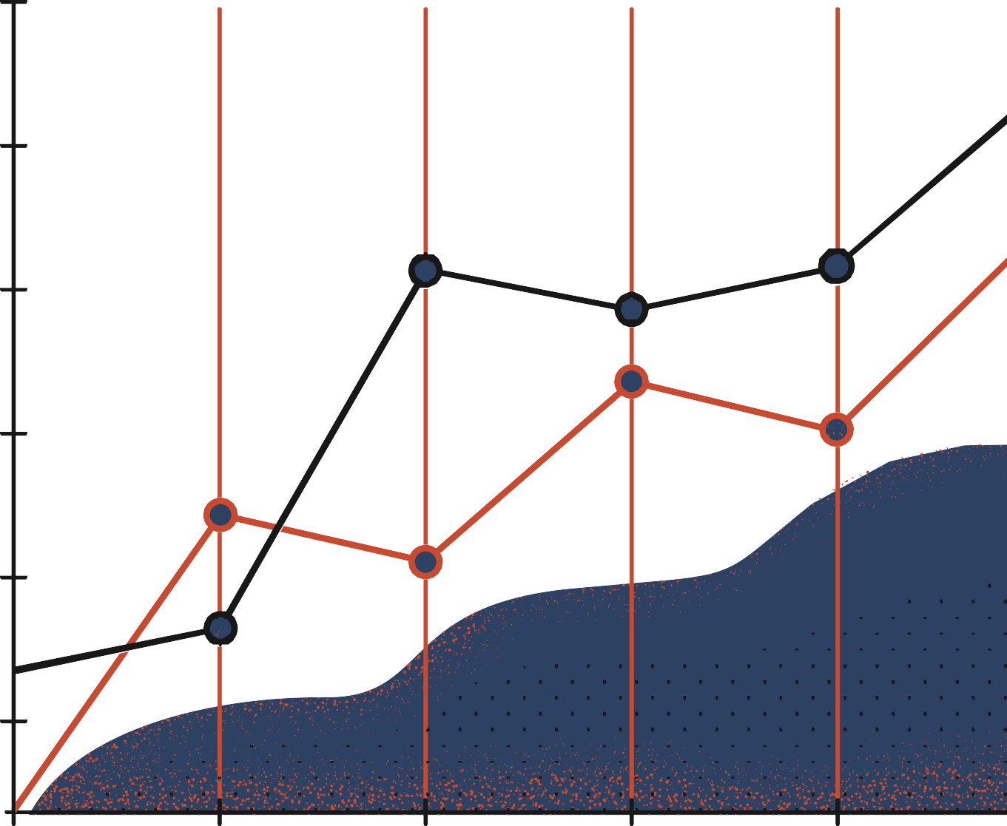


Introduction to ANN and Perceptron
Pavlos Protopapas

Slide 2
Outline
Introduction
Review of basic concepts
Perceptron - Single neuron network
Multi-Layer Perceptron (MLP)

Slide 3
Outline
Introduction
Review of basic concepts
Perceptron - Single neuron network
Multi-Layer Perceptron (MLP)

Slide 4
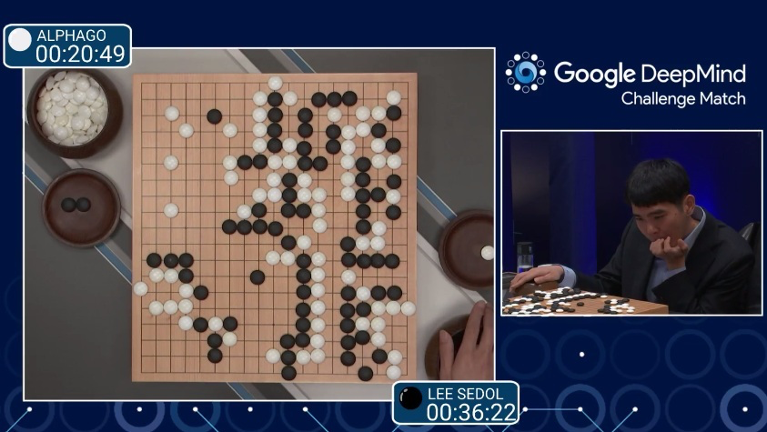

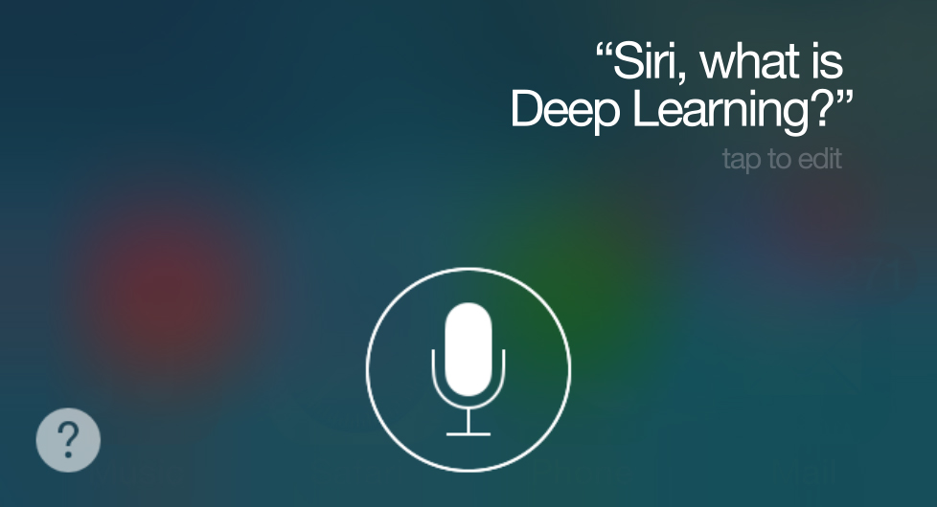
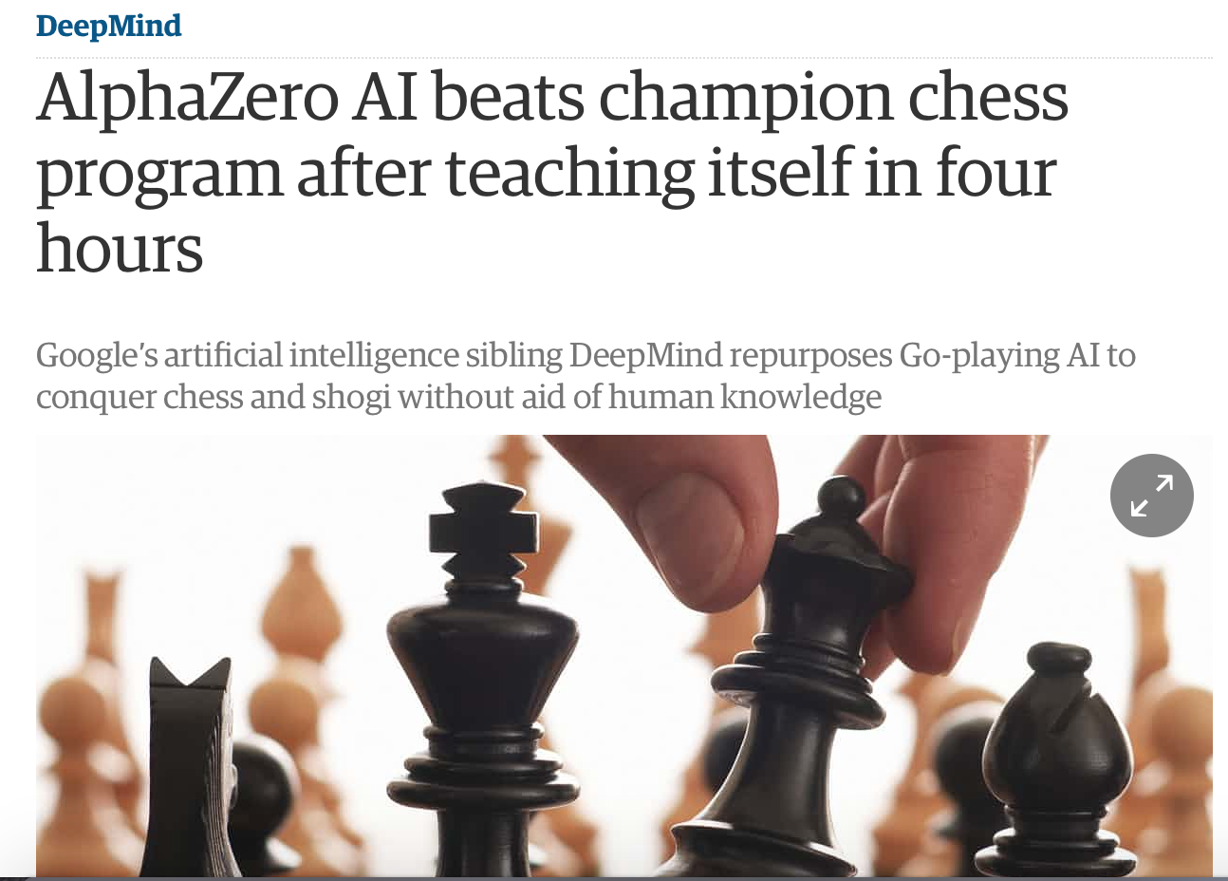
Historical Trends
Game strategy
Disease prediction
Natural Language Processing
2011
2018
2017

Slide 5
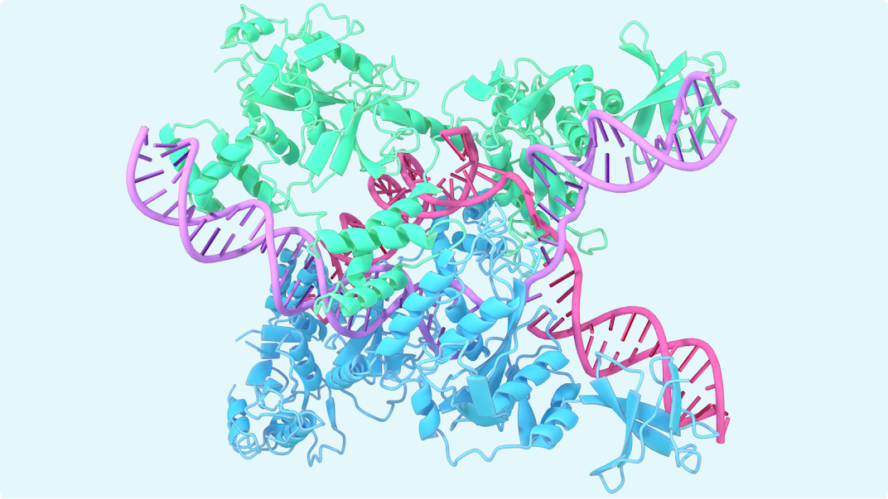
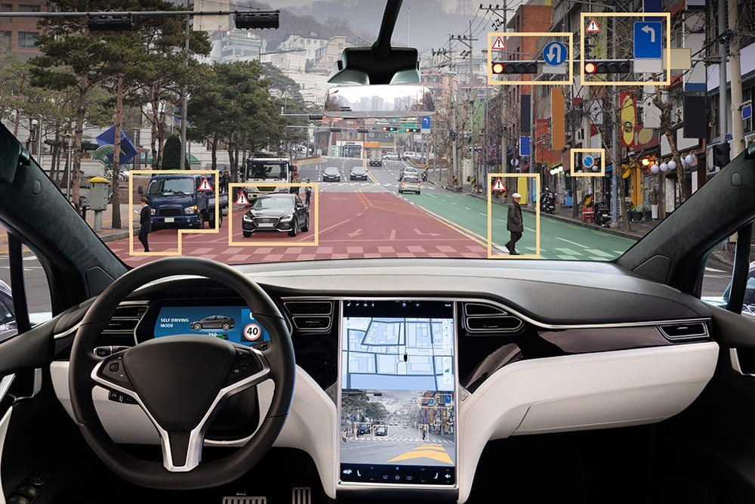
Recent developments
Protein folding
Autonomous cars
AlphaFold, a DeepMind AI, revolutionized biochemistry by solving the long-standing protein folding problem.
AI Detecting objects to assist with autonomous driving.
2020

Slide 6


Recent developments
Image Reconstruction from Sparse Frequency Measurements
Text to Image Generation
Katie Bouman’s CHIRP produces the first-ever image of a black hole.
Notes:
https://www.youtube.com/watch?v=PQCrX1sQSzY

Slide 7

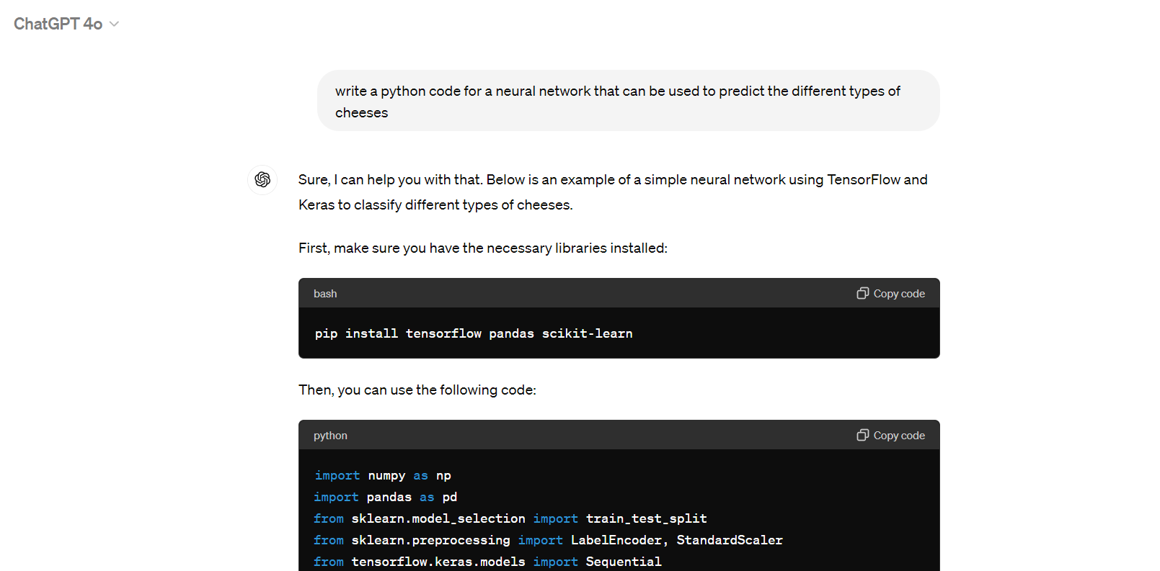


Recent developments
Personalized Customer Assistance
Computer Code Generation
AI Conversational Assistant
Notes:
https://www.youtube.com/watch?v=PQCrX1sQSzY

Slide 8
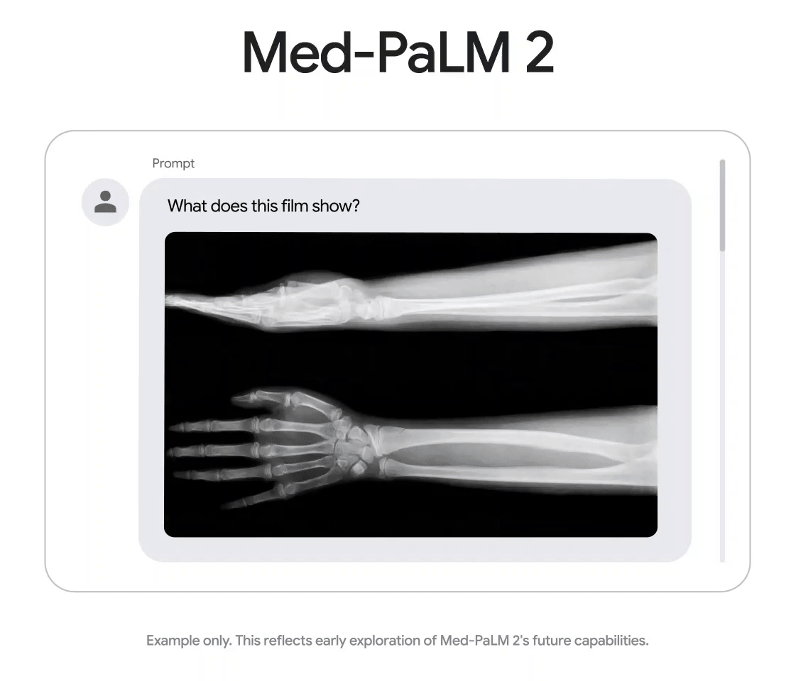
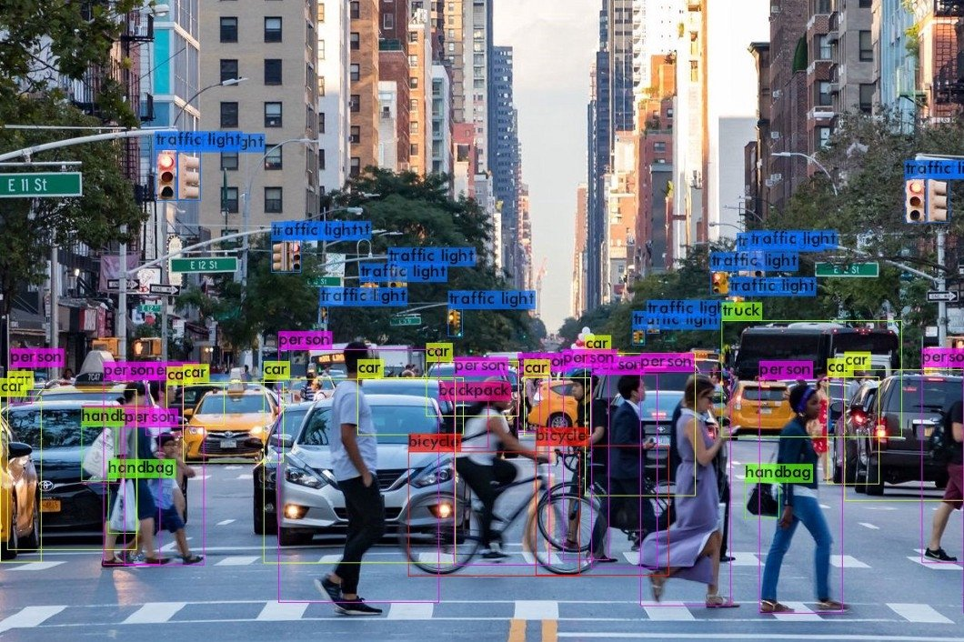
Recent developments
Disease Prediction
Complex Object Detection
Google, 2023
2024, YOLOv5
Notes:
https://www.youtube.com/watch?v=PQCrX1sQSzY

Slide 9


The potential challenges in Data Science
Gender Bias
Racial Bias
Some DS models for evaluate job applications show bias in favor of male candidate
Risk models used in US courts have shown to be biased against non-white defendants
Notes:
compas dataset recidivism

Slide 10
Outline
Introduction
Review of basic concepts
Perceptron - Single neuron network
Multi-Layer Perceptron (MLP)

Slide 11
What is Machine Learning?
TRADITIONAL PROGRAMMING
MACHINE LEARNING
INPUT
INPUT
OUTPUT
GET LABELED DATA
GENERAL
PROGRAMMING
MACHINE
LEARNING
OUTPUT
NEW INPUT
LEARNED PROGRAM
INFERRED
OUTPUT

Slide 12
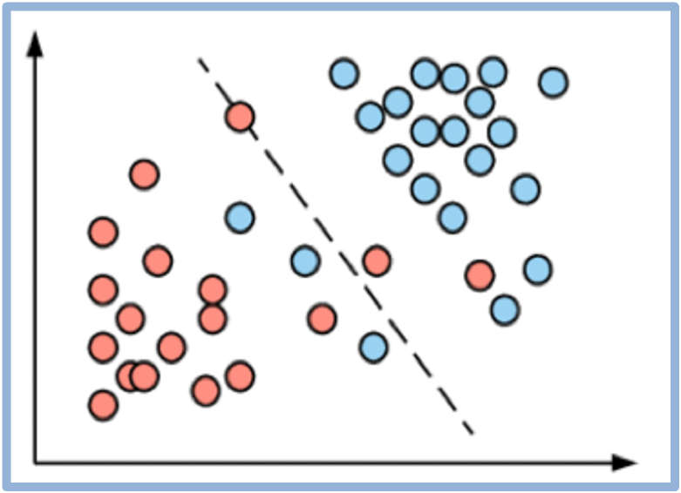
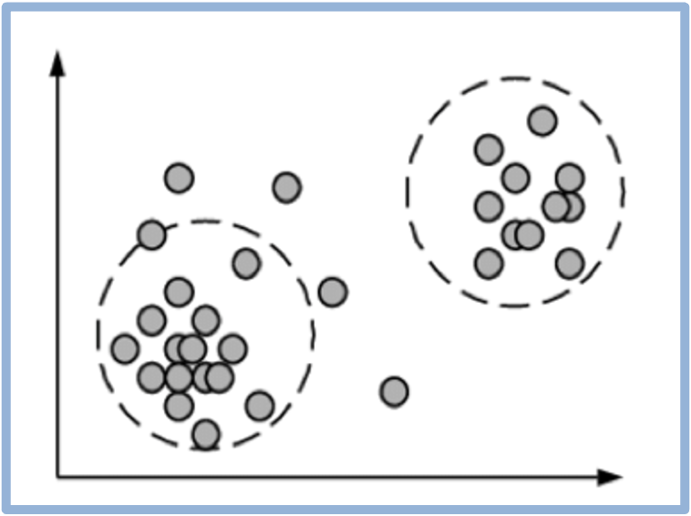
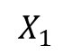
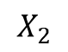
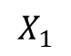
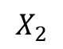
Supervised v/s Unsupervised Machine Learning
$$X_{2}$$
$$X_{2}$$
$$X_{1}$$
$$X_{1}$$
Supervised Learning: Learns with “labeled” data
Unsupervised Learning: Learns by clustering or association

Slide 13
Building blocks of supervised machine learning
SUPERVISED MACHINE LEARNING WORKFLOW
GET LABELED DATA
SELECT MODEL
DEFINE LOSS
FUNCTION
MINIMIZE LOSS

Slide 14
Building blocks of supervised machine learning
SUPERVISED MACHINE LEARNING WORKFLOW
GET LABELED DATA
SELECT MODEL
DEFINE LOSS
FUNCTION
MINIMIZE LOSS

Slide 15
Building blocks of supervised machine learning
SUPERVISED MACHINE LEARNING WORKFLOW
GET LABELED DATA
Regression, Classification, Object Detection
SELECT MODEL
DEFINE LOSS
FUNCTION
MINIMIZE LOSS

Slide 16
Building blocks of supervised machine learning
SUPERVISED MACHINE LEARNING WORKFLOW
GET LABELED DATA
Regression, Classification, Object Detection
SELECT MODEL
Mean Squared Error,
Binary Cross Entropy, Categorical Cross Entropy, Hinge Loss
DEFINE LOSS
FUNCTION
MINIMIZE LOSS

Slide 17
Building blocks of supervised machine learning
SUPERVISED MACHINE LEARNING WORKFLOW
GET LABELED DATA
Regression, Classification, Object Detection
SELECT MODEL
Mean Squared Error,
Binary Cross Entropy, Categorical Cross Entropy, Hinge Loss
DEFINE LOSS
FUNCTION
Analytical solution,
Gradient Descent
MINIMIZE LOSS

Slide 18
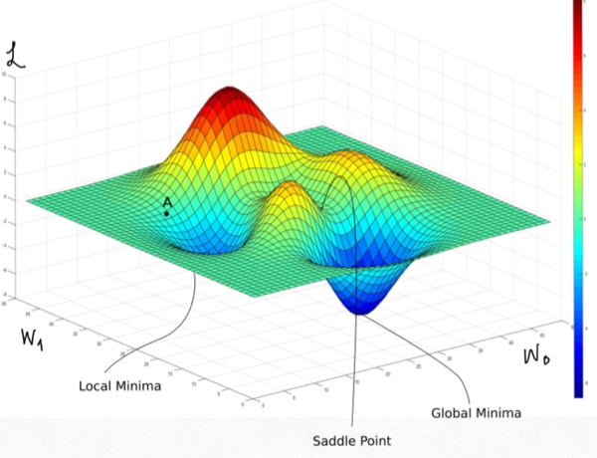
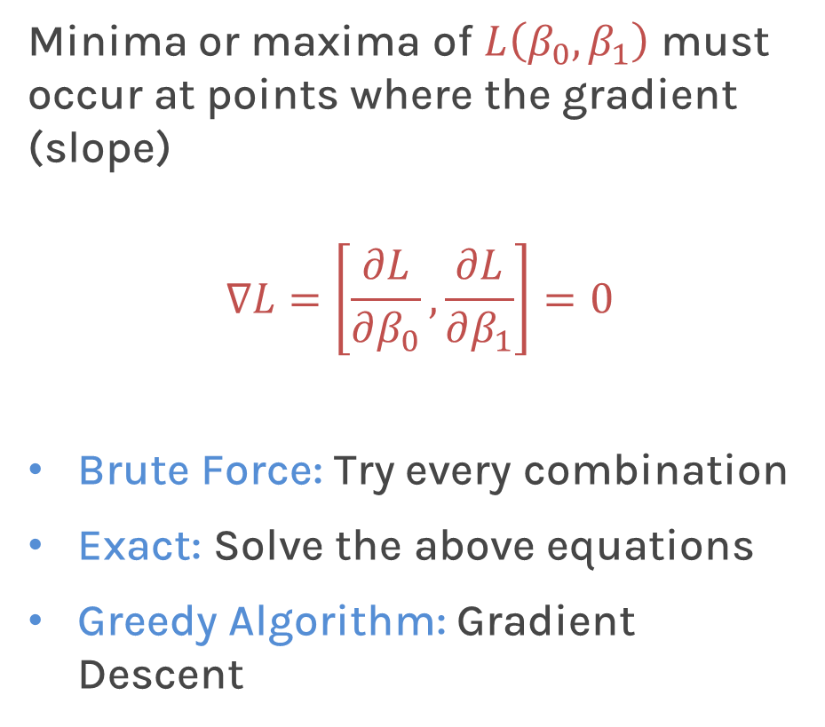
Optimization
How does one minimize a loss function?
Minima or maxima of $L\left(β_{0},β_{1}\right)$ must occur at points where the gradient (slope)
$$∇L=\left[\frac{∂L}{∂β_{0}},\frac{∂L}{∂β_{1}}\right]=0$$
Brute Force: Try every combination
Exact: Solve the above equations
Greedy Algorithm: Gradient Descent
Notes:
Shall I add a contour plot?

Slide 19
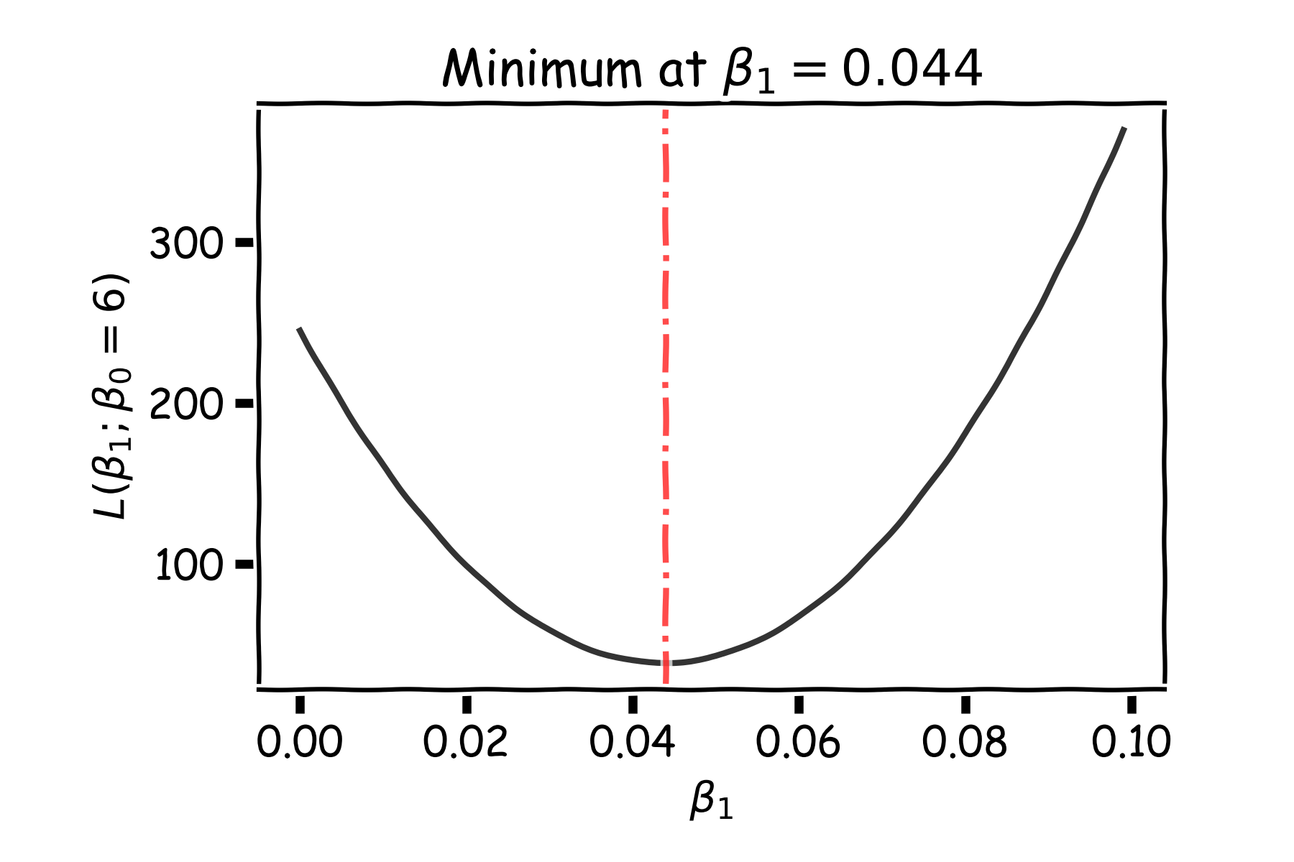
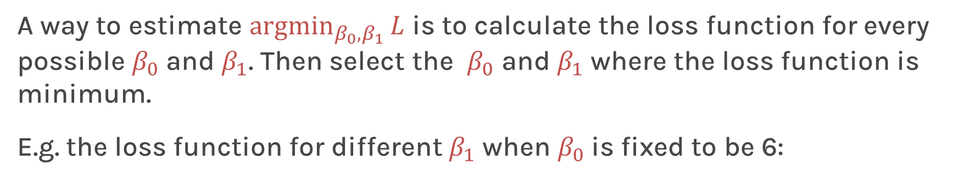
Optimization: Brute force
A way to estimate ${argmin}_{β_{0},β_{1}}{L}$ is to calculate the loss function for every possible $β_{0}$ and $β_{1}$. Then select the $β_{0}$ and $β_{1}$ where the loss function is minimum.
E.g. the loss function for different $β_{1}$ when $β_{0}$is fixed to be 6:
Very computationally expensive with many coefficients
Notes:
Shall I add a contour plot?

Slide 20
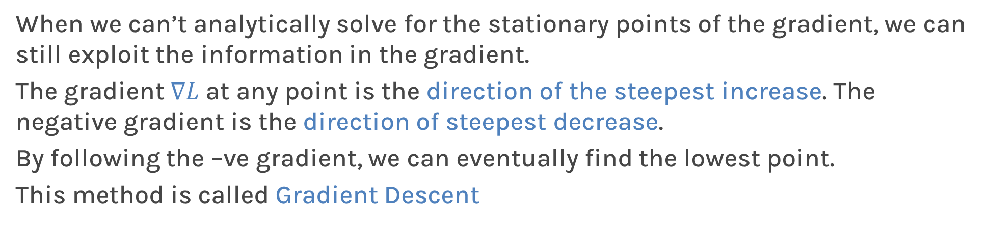
Gradient Descent
When we can’t analytically solve for the stationary points of the gradient, we can still exploit the information in the gradient.
The gradient $∇L$ at any point is the direction of the steepest increase. The negative gradient is the direction of steepest decrease.
By following the –ve gradient, we can eventually find the lowest point.
This method is called Gradient Descent

Slide 21
Outline
Introduction
Review of basic concepts
Perceptron - Single neuron network
Multi-Layer Perceptron (MLP)

Slide 22

Logistic Regression Revisited
Before we understand what, a perceptron is, let’s look at a machine learning model which we had talked about in a previous lecture.
Logistic Regression

Slide 23
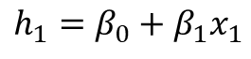
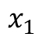

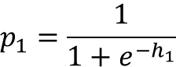
Logistic Regression Revisited
Data
Loss
True $y$
Affine
Activation
Loss Func
$$x_{1}$$
$$h_{1}=β_{0}+β_{1}x_{1}$$
$$p_{1}=\frac{1}{1+e^{−h_{1}}}$$
$$ℒ_{1}\left(β\right)=−y_{1}\ln\left(p_{1}\right)−\left(1−y_{1}\right)ln⁡(1−p_{1})$$
Pred

Slide 24
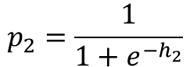
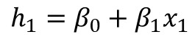
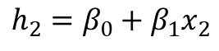
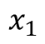
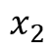
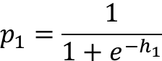
Logistic Regression Revisited
Affine
Activation
Loss Func
$$x_{1}$$
$$h_{1}=β_{0}+β_{1}x_{1}$$
$$p_{1}=\frac{1}{1+e^{−h_{1}}}$$
$$ℒ_{1}\left(β\right)=−y_{1}\ln\left(p_{1}\right)−\left(1−y_{1}\right)ln⁡(1−p_{1})$$
Affine
Activation
Loss Func
$$x_{2}$$
$$h_{2}=β_{0}+β_{1}x_{2}$$
$$p_{2}=\frac{1}{1+e^{−h_{2}}}$$
$$ℒ_{2}\left(β\right)=−y_{2}\ln\left(p_{1}\right)−\left(1−y_{2}\right)ln⁡(1−p_{2})$$

Slide 25
Logistic Regression Revisited
Affine
Activation
Loss Func
$$x_{1}$$
$$h_{1}=β_{0}+β_{1}x_{1}$$
$$p_{1}=\frac{1}{1+e^{−h_{1}}}$$
$$ℒ_{1}\left(β\right)=−y_{1}\ln\left(p_{1}\right)−\left(1−y_{1}\right)ln⁡(1−p_{1})$$
Affine
Activation
Loss Func
$$x_{2}$$
$$h_{2}=β_{0}+β_{1}x_{2}$$
$$p_{2}=\frac{1}{1+e^{−h_{2}}}$$
$$ℒ_{2}\left(β\right)=−y_{2}\ln\left(p_{1}\right)−\left(1−y_{2}\right)ln⁡(1−p_{2})$$
…
…
…

Slide 26
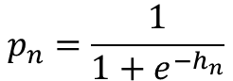
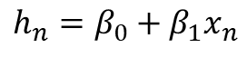
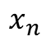
Logistic Regression Revisited
Affine
Activation
Loss Func
$$x_{1}$$
$$h_{1}=β_{0}+β_{1}x_{1}$$
$$p_{1}=\frac{1}{1+e^{−h_{1}}}$$
$$ℒ_{1}\left(β\right)=−y_{1}\ln\left(p_{1}\right)−\left(1−y_{1}\right)ln⁡(1−p_{1})$$
Affine
Activation
Loss Func
$$x_{2}$$
$$h_{2}=β_{0}+β_{1}x_{2}$$
$$p_{2}=\frac{1}{1+e^{−h_{2}}}$$
$$ℒ_{2}\left(β\right)=−y_{2}\ln\left(p_{1}\right)−\left(1−y_{2}\right)ln⁡(1−p_{2})$$
…
…
…
Affine
Activation
Loss Func
$$x_{n}$$
$$h_{n}=β_{0}+β_{1}x_{n}$$
$$p_{n}=\frac{1}{1+e^{−h_{n}}}$$
$$ℒ_{n}\left(β\right)=−y_{n}\ln\left(p_{n}\right)−\left(1−y_{n}\right)ln⁡(1−p_{1n})$$

Slide 27
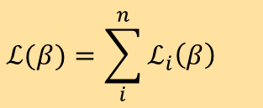
Logistic Regression Revisited
Affine
Activation
Loss Func
$$x_{1}$$
$$h_{1}=β_{0}+β_{1}x_{1}$$
$$p_{1}=\frac{1}{1+e^{−h_{1}}}$$
$$ℒ_{1}\left(β\right)=−y_{1}\ln\left(p_{1}\right)−\left(1−y_{1}\right)ln⁡(1−p_{1})$$
Affine
Activation
Loss Func
$$x_{2}$$
$$h_{2}=β_{0}+β_{1}x_{2}$$
$$p_{2}=\frac{1}{1+e^{−h_{2}}}$$
$$ℒ_{2}\left(β\right)=−y_{2}\ln\left(p_{1}\right)−\left(1−y_{2}\right)ln⁡(1−p_{2})$$
…
…
…
Affine
Activation
Loss Func
$$x_{n}$$
$$h_{n}=β_{0}+β_{1}x_{n}$$
$$p_{n}=\frac{1}{1+e^{−h_{n}}}$$
$$ℒ_{n}\left(β\right)=−y_{n}\ln\left(p_{n}\right)−\left(1−y_{n}\right)ln⁡(1−p_{1n})$$
$$ℒ(β)=\sum_{i}^{n}{ℒ_{i}\left(β\right)}$$

Slide 28
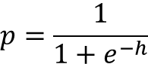
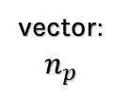
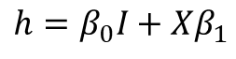
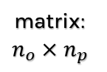
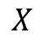
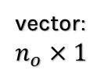
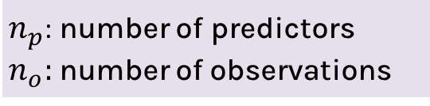
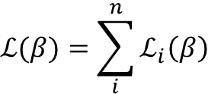
Build our first ANN
$n_{p}$: number of predictors
$n_{o}:$ number of observations
matrix: $n_{o}×n_{p}$
vector: $n_{o}×1$
vector: $n_{p}$
Affine
Activation
Loss Fun
$$ℒ(β)=\sum_{i}^{n}{ℒ_{i}\left(β\right)}$$
$$p=\frac{1}{1+e^{−h}}$$
$$X$$
$$h=β_{0}I+{Xβ}_{1}$$
scalar

Slide 29
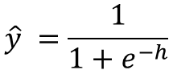
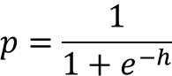
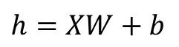
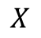
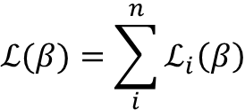
Build our first ANN
Affine
Activation
Loss Fun
$$ℒ(β)=\sum_{i}^{n}{ℒ_{i}\left(β\right)}$$
$$X$$
$$p=\frac{1}{1+e^{−h}}$$
$$h=β_{0}I+{Xβ}_{1}$$
Affine
Activation
Loss Fun
$$\hat{y} =\frac{1}{1+e^{−h}}$$
$$ℒ(β)=\sum_{i}^{n}{ℒ_{i}\left(β\right)}$$
$$X$$
$$h=XW+b$$
Weights

Slide 30
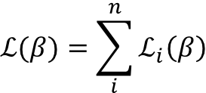
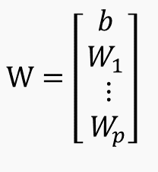
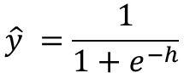
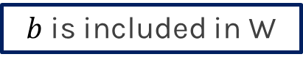




Build our first ANN
Affine
Activation
Loss Fun
$$ℒ(β)=\sum_{i}^{n}{ℒ_{i}\left(β\right)}$$
$$X$$
$$p=\frac{1}{1+e^{−h}}$$
$$h=β_{0}I+{Xβ}_{1}$$
Affine
Activation
Loss Fun
$$\hat{y} =\frac{1}{1+e^{−h}}$$
$$ℒ(β)=\sum_{i}^{n}{ℒ_{i}\left(β\right)}$$
$$X$$
$$h=XW+b$$
Affine
Activation
Loss Fun
$$\hat{y}=\frac{1}{1+e^{−h}}$$
$$ℒ(β)=\sum_{i}^{n}{ℒ_{i}\left(β\right)}$$
$$X$$
$$h=XW$$
$$W=\left[\begin{aligned}b \\ W_{1} \\ \begin{aligned}⋮ \\ W_{p}\end{aligned}\end{aligned}\right]$$
$$X=\left[\begin{matrix}1 & X_{11} & … \\ 1 & ⋮ & … \\ 1 & X_{o1} & …\end{matrix}\begin{aligned} X_{1p} \\ ⋮ \\ X_{op}\end{aligned}\right]$$
$b$ is included in W

Slide 31




Build our first ANN
Affine
Activation
Loss Fun
$$ℒ(W)=\sum_{i}^{n}{ℒ_{i}\left(W\right)}$$
$$X$$
$$h=XW$$
$$\hat{y} =\frac{1}{1+e^{−h}}$$

Slide 32
Build our first ANN
Affine
Activation
Loss Fun
$$ℒ(W)=\sum_{i}^{n}{ℒ_{i}\left(W\right)}$$
$$X$$
$$h=XW$$
$$\hat{y} =\frac{1}{1+e^{−h}}$$

Slide 33

Build our first ANN
Affine
Activation
Loss Fun
$$ℒ(W)=\sum_{i}^{n}{ℒ_{i}\left(W\right)}$$
$$X$$
$$h=XW$$
$$\hat{y} =\frac{1}{1+e^{−h}}$$
“Sigmoid activation” $σ$

Slide 34




Build our first ANN
Affine
Activation
Loss Fun
$$ℒ(W)=\sum_{i}^{n}{ℒ_{i}\left(W\right)}$$
$$X$$
$$h=XW$$
$$\hat{y} =\frac{1}{1+e^{−h}}$$
A neuron is where the affine transformation and activation takes place.
$$XW$$
$$σ$$
$$Y$$
$$X$$
Neuron

Slide 35



Build our first ANN
Affine
Activation
Loss Fun
$$ℒ(W)=\sum_{i}^{n}{ℒ_{i}\left(W\right)}$$
$$X$$
$$h=XW$$
$$\hat{y} =\frac{1}{1+e^{−h}}$$
$$W$$
$$σ$$
$$Y$$
$$X$$
Single Neuron Neural “Network”

Slide 36









A single neuron
Up to this point we just re-branded logistic regression to look like a neuron.
How about linear regression?
no activation
Activation
Loss
Function
$$ℒ(β)=\sum_{i}^{n}{ℒ_{i}\left(β\right)}$$
$$X$$
Affine
$$h=β_{0}I+β_{1}X$$
$$y=h$$
Identity
$$W$$
$$I$$
$$Y$$
$$X$$
Where $I$ is the identity function

